Slide 1
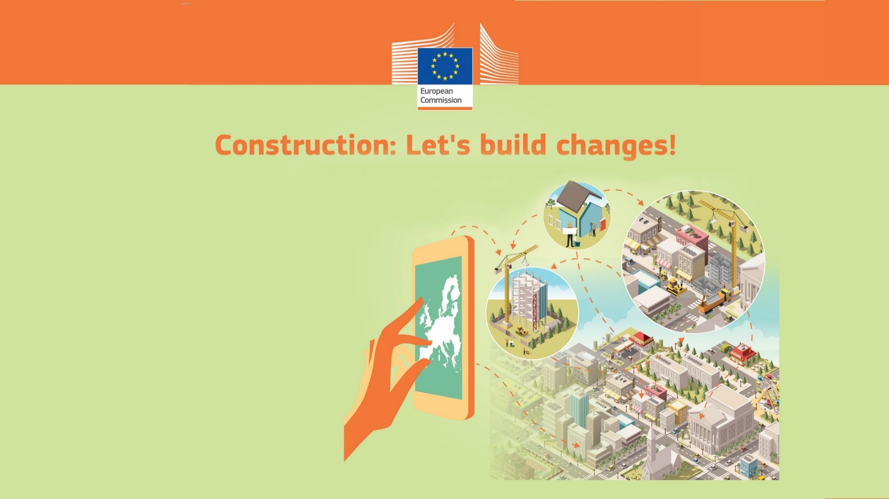
From Construction 2020
to a new vision for the
EU Built Environment
Ilektra PAPADAKI
Policy Officer
Directorate General for Internal Market, Industry, Entrepreneurship and SMEs
European Commission

Slide 2
Construction 2020
Strategy for the sustainable competitiveness of the construction sector and its enterprises (2012)
Construction 2020 Action Plan (2013)
Thematic Objectives
Innovation
Skills and qualifications
Resource efficiency
Regulatory framework
Internationalisation
Each thematic objective is supported by a stakeholder thematic group and the High Level Forum.
The European Construction Sector Observatory measures the progress towards Con2020 targets.

Slide 3

Thematic objectives
Construction 2020
Innovation
Uptake of Digitalisation
Support to SMEs
Public Procurement
EU BIM TASK GROUP
Buildings Digital Logbook
Digital Industrial Platform for construction
Study and support to SMEs to digitalise
Smart finance for smart buildings
Smart Readiness Indicator
(SRI)
KEY INITIATIVES

Slide 4

Thematic objectives
Construction 2020
2. Skills and Qualifications
An industry that delivers while people are valued
Upskilling and reskilling
Attractiveness of the sector
Health and Safety
Blueprint for Sectoral cooperation on skills
Apprenticeship pledges
Built up skills
Blueprint for Operational Health and Safety
KEY INITIATIVES

Slide 5

Thematic objectives
Construction 2020
3. Resource Efficiency and
Circular Economy
Energy
C&D
Building stock observatory
C&D waste protocol and roadshow
Energy Efficiency and labelling
Eco-design
Level(S)
BAMB
EPBD (Energy performance on buildings directive)
Circular Economy Package
Pre-demolition audit
KEY INITIATIVES

Slide 6
Thematic objectives
Construction 2020
4. Regulatory Framework
Construction Products Regulation (CPR)
Fire Information Exchange Platform (FIEP).
5. Internationalisation
KEY INITIATIVES
Eurocodes
Assessment of Cross-border trade of Construction Products, production and trade data.

Slide 7
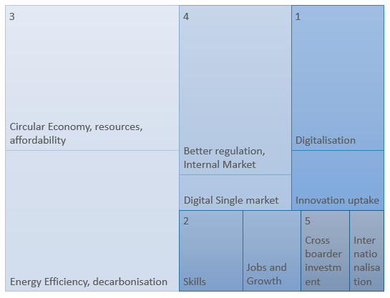
What do stakeholders say on the future of Construction 2020?
‘’Explore working with cities. They have an interesting point of view of what they need from the construction products , services and the C&D operators.’’
‘Involve actors from all the value chain to address lifecycle performance’’
‘Vision 2050’’
[n=188]

Slide 8
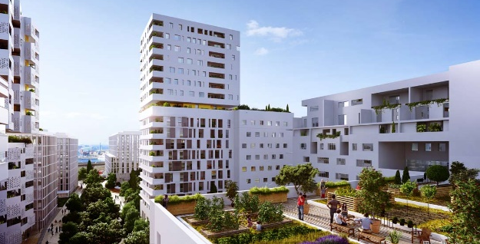
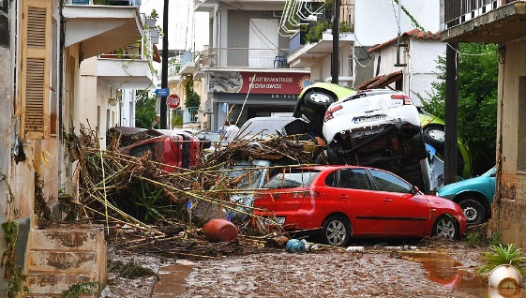
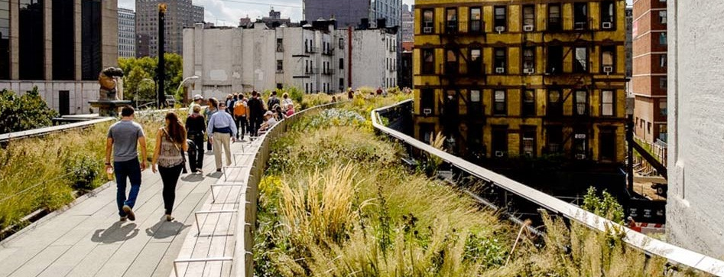
The average expectancy of life in Hong Kong can vary for up to 10 years depending on the district of residence.
The built environment consumes 50% of all extracted materials.
Most of EU buildings serve for 70 years in average
Political drivers
  SDGs, Paris Agreement
  Green Deal, Circular Economy Action Plan
  Jobs and Growth
Critical elements
complex EU built environment
long service life, cultural settings
future proofing
digitalization and digital economy
climate crisis
social challenges
quality of life

Slide 9
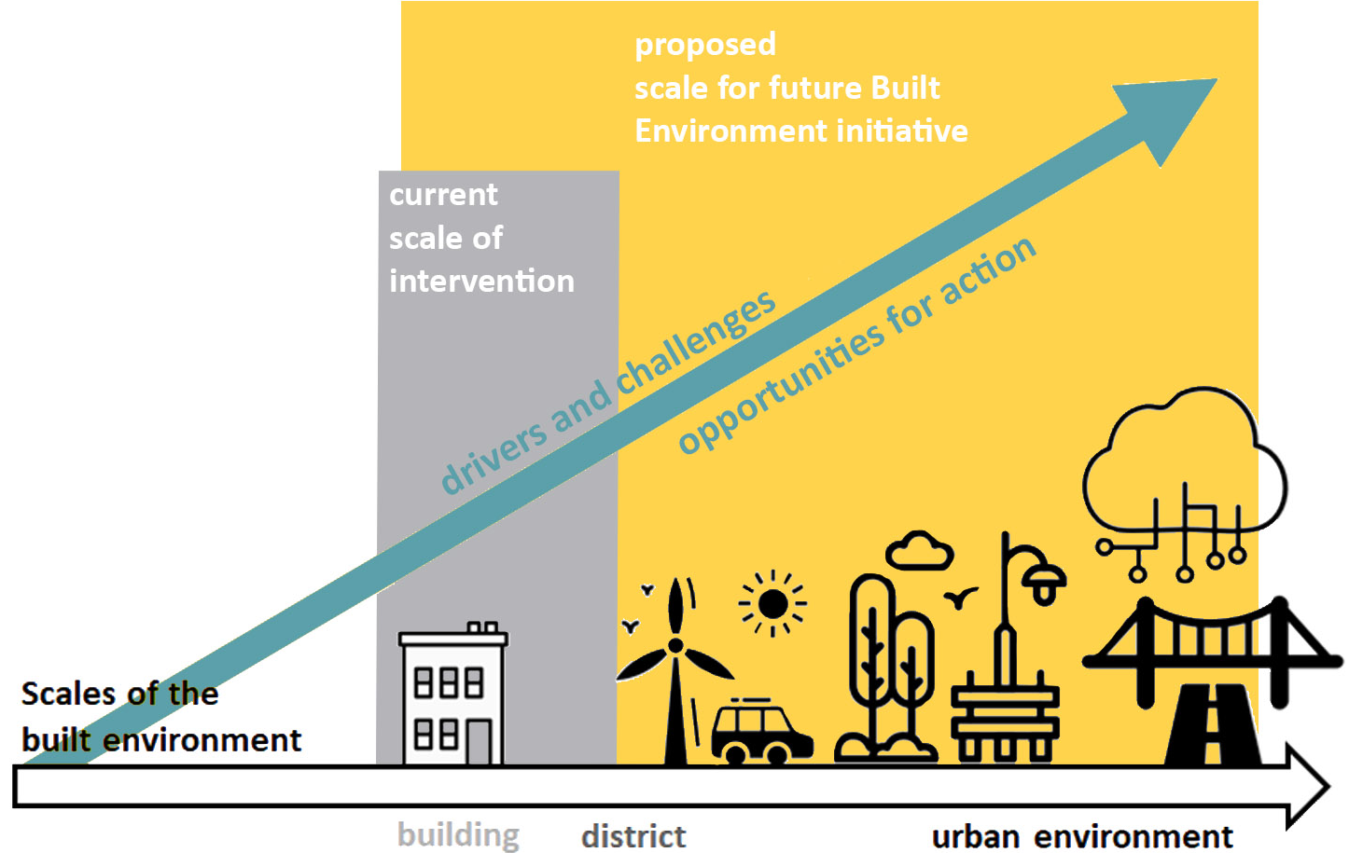
What’s next?

Slide 10
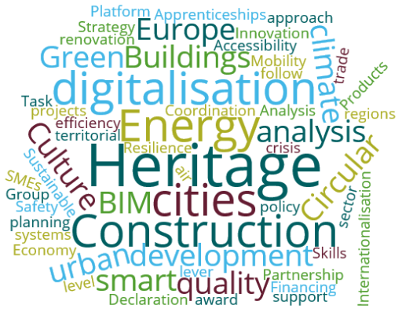
Built Environment
Built Environment is defined as the product of construction. It is the human-made space in which people live, work, and recreate on a day-to-day basis including buildings, parks, public spaces and infrastructure for utilities, mobility and leisure.
It is recognised that the contribution of a “high-quality Built Environment is crucial to achieving a sustainable society, characterised by a high quality of life, cultural diversity, individual and collective well-being, social justice and cohesion, and economic efficiency”.

Slide 11
What happens in other international organisations?
The OECD recognised the link between cities, good governance and urban development early on. Its publication of 2000, “Shaping the Urban Environment in the 21st Century”, recognised that cities hold the potential for providing healthy and safe living environments and that good urban governance can insure that investments made in construction match the priorities of citizens and businesses, which requires transparent and participatory processes. This already provided a recognition that government and the construction sector can cooperate to build safe living environments.
UN-Habitat has developed a holistic and global approach towards urbanization that embraces much more than just technical considerations. Beyond its traditional core areas — such as city planning, infrastructure development, and participatory slum upgrading — UN-Habitat, today, also focuses on urban legislation and risk management, as well as gender, youth and capacity building for all actors involved in the urbanization process.
UN Habitat’s 2016 Guidelines for Developing Eco-Efficient and Socially Inclusive Infrastructure brings built environment concepts back to infrastructure policies. It calls for an urgent shift in the way urban infrastructure is planned, designed and managed. It sets forth guidelines for policy makers in the planning, designing and managing of urban infrastructure with a central message is an integrated approach, taking into account principles and criteria of eco-efficiency and social inclusiveness.
The World Economic Forum, Shaping the Future of Construction (2016) is the first publication of a multi-year project guiding and supporting the current transformation of the engineering and construction industry. The publication recognises the construction industry’s potential for positively influencing society, the barriers it currently faces to be able to do so and puts forward an industry transformation framework, with good practices and measure both for the private as well as the public sector.

Slide 12


And what’s on
Research and Innovation?
Horizon2020 Partnership on energy efficiency in Buildings →
Horizon Europe partnership Sustainable Built Environment (Built4People)
Horizon Europe Mission on
Smart and Climate neutral cities ←
Built environment as enabler
And in EU MS?
In MS level we start to see strategies on Built Environment (ex. Estonia), or Construction policy was in the agenda of Housing, Environment, Infrastructure or other ministries.
In many Ministerial portfolios there is the sense of ‘sustainable built environment’ as the final goal.

Slide 13
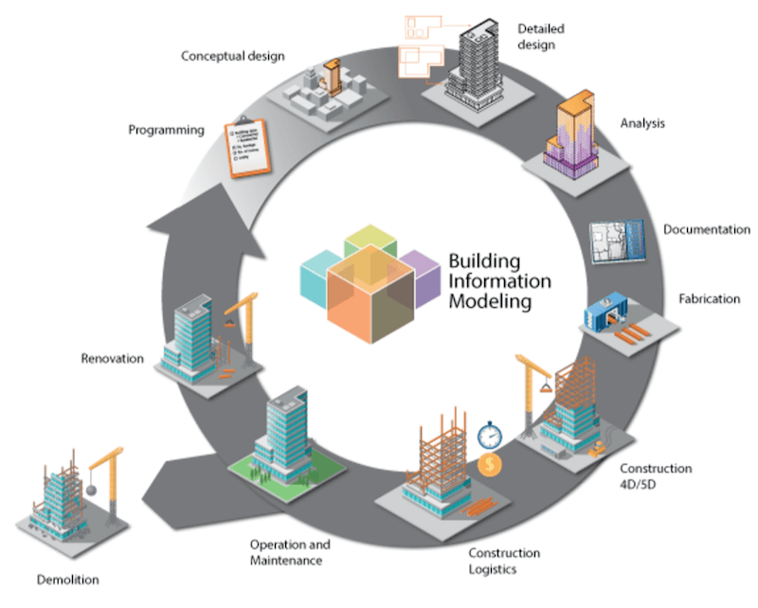
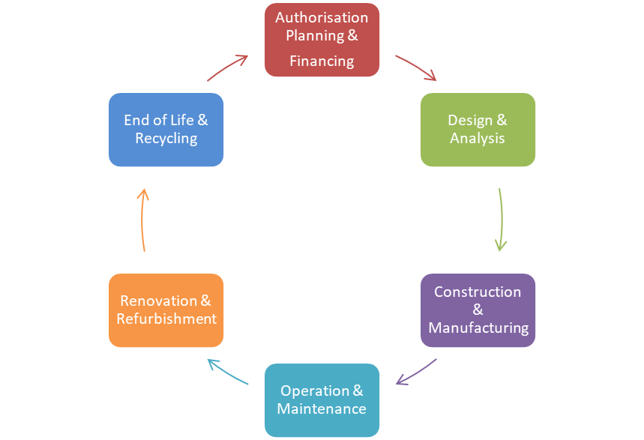
Life Cycle approach
Costing!
ICMS
From a purely sectoral to an integrated, multi-level and multidisciplinary approach!

Slide 14
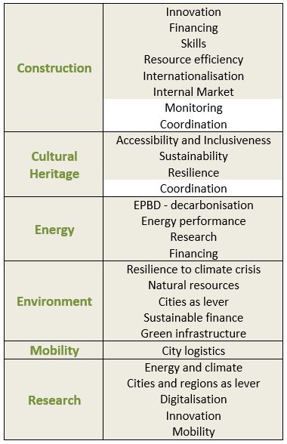
Cross-services areas of action
Innovation and digitalisation, resource efficiency and climate are cross-cutting issues, as well as a tendency to work closer with local authorities, as a lever of implementing policies more effectively.
Joint actions could bring
more impact!
But on what principle?

Slide 15



Environmental, Social and Economic Sustainability
Integration of multiple circular, environmental and resource efficiency targets.
Built environment as a resource.
Participatory methods.
Life cycle approach in the estimation of social impacts.
Built Environment for all.
Adequate housing.
Participatory methods.
Life cycle approach in the estimation of social impacts.
Industry that delivers.
Empower EU construction value chain to transform and innovate.
Investment, innovative public procurement, upskilling, and digitalisation.

Slide 16
Key elements for a future strategy on built environment:
Life cycle and multidisciplinary approach;
Urban environment as the limit of the scale of intervention;
Human and environmental centric approach instead of purely market centric;
Informed decision making when it comes to trade-offs;
Sufficiently long horizon (ex. 2050).

Slide 17


The 3 pillars of Sustainability with Digitalisation and Local Action as cross-cutting issues open a lot of areas for action
Resource efficiency
Decarbonisation
Circular economy
Urban Sprawl
Natural resources
Resilience to climate and social crisis
Digitalisation of the built environment
Digital Economy related challenges
Strategic Public Procurement
Skills for the workforce
Skills for policy makers
Accessibility, Affordability, Gentrification
Safety
Culture and heritage as a tool to territorial competitiveness
Competitive Industry that can deliver
Internal market
Internationalisation
Export of local know-how
Financing

Slide 18

And now, to you!
What would you expect from a future EU strategy on the Built Environment?
Which ones should be the main pillars?
What actions would you like to see in EU, national and local level?

Slide 19
Thank you!
ilektra.papadaki@ec.europa.eu
Useful links
Construction and Built Environment
https://ec.europa.eu/growth/sectors/construction/competitiveness_en
European Construction Sector Observatory
https://ec.europa.eu/growth/sectors/construction/observatory_en
EU BIM Task Group www.eubim.eu

