Slide 1


ICMS: standardizing global life cycle costs
Alan Muse BSc (Hons) MSc FRICS
Global Director of the Built Environment , RICS
Vice - Chair ICMS Standard Setting Committee
Chair FIG QS Commission

Slide 2
Construction is changing …….

Slide 3
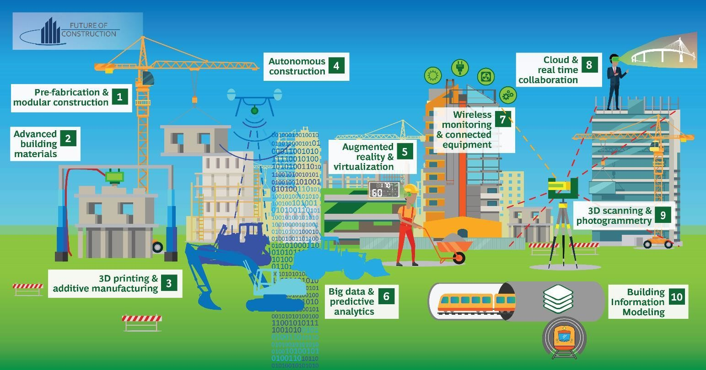

Slide 4
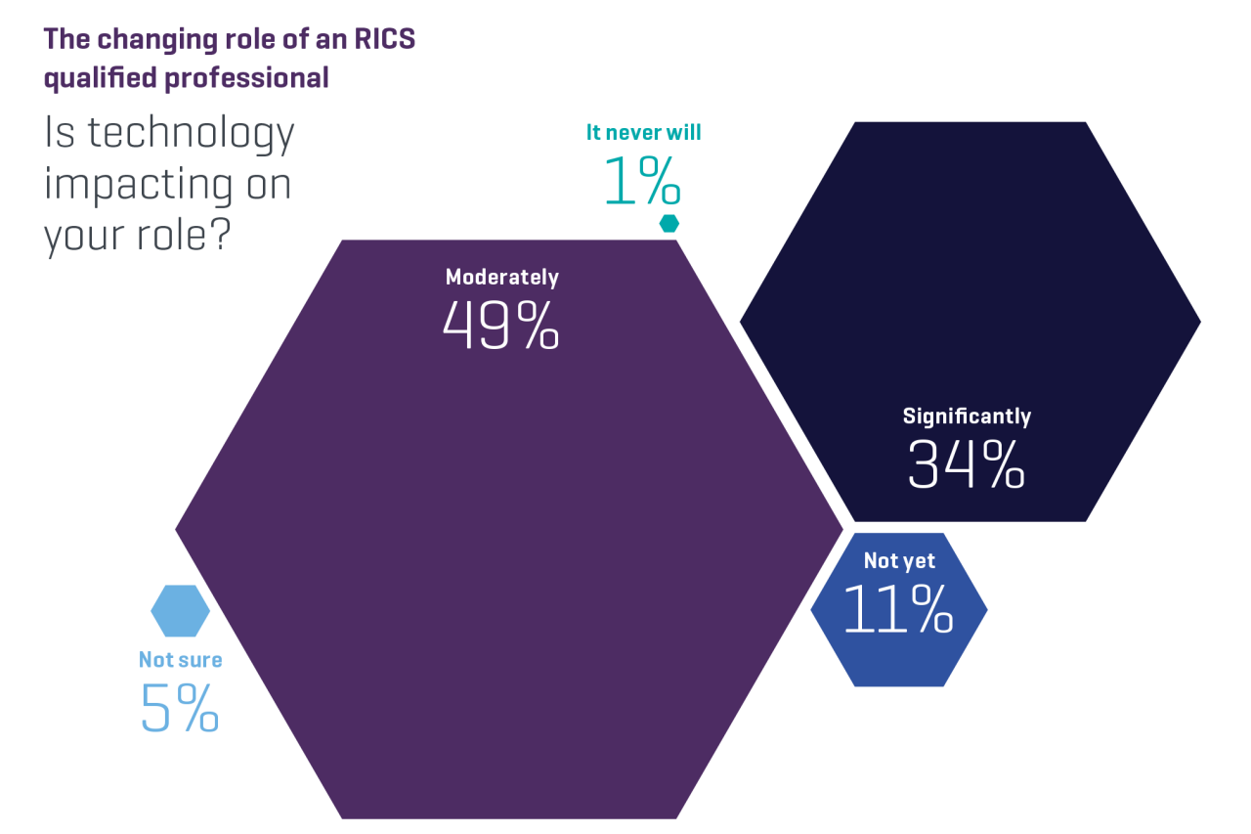

Slide 5
A brief ICMS recap…….

Slide 6























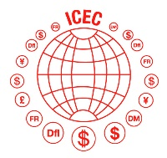



















Notes:
Today, we’re 46 and growing!
All of the major professional and standard-setting bodies in this sector, from all around the world, including:
Canada,
US
UK
France
Germany
Japan
Hong Kong
Australia
China
Brazil
The list goes on…

Slide 7










Slide 8
International Bodies | World Bank | IMF | G20 Infrastructure Hub | World Economic Forum | European Commission
Governments | USA-GAO | UK – DfT, Cabinet Office, National Audit Office, MHCLG | UAE | Qatar | Ireland | South Africa | Vietnam
Major Clients | Network Rail, UK | Highways England | Infrastructure Ontario, Canada | WAMTA, USA | Irish Housing Agency | BAM, Netherlands | IATA | China National Aviation Fuel Group | State Grid Corporation of China | China Harbour Engineering | China Railway Construction Group | IBM | Hong Kong Jockey Club

Slide 9
Where ICMS 2 takes us…….

Slide 10
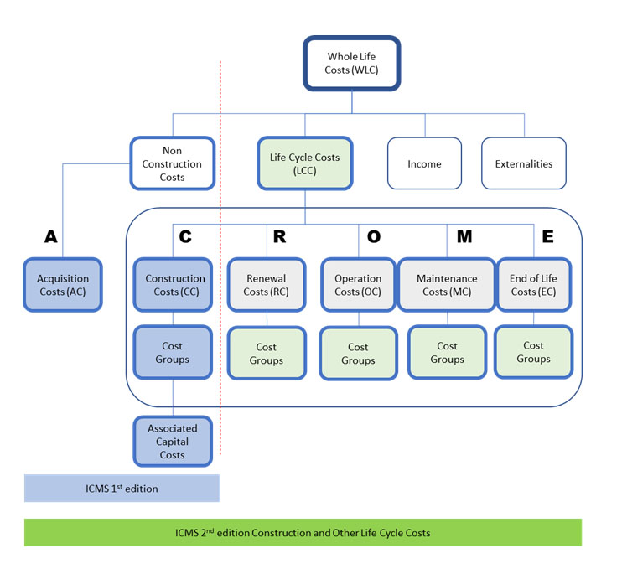

Slide 11
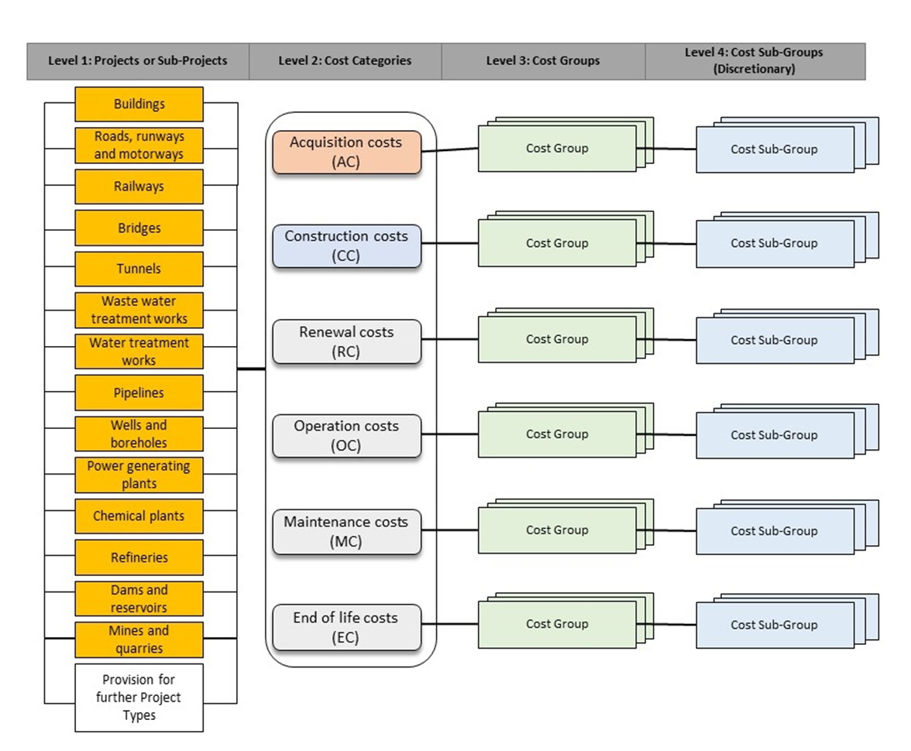

Slide 12
Integrating FM and construction…….

Slide 13
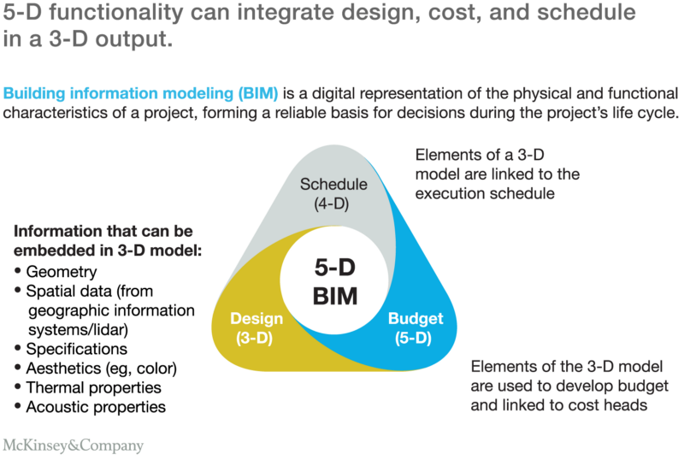

Slide 14
The future in five…….

Slide 15
Accelerate adoption with NGO’s and governments
Make nationally relevant
Embrace a whole life cycle approach
Integrate into digital construction
Gather, share and enable the data

Slide 16
www.icms-coalition.org

