Slide 1


The Irish Government and BIM: the next four years
Mary Flynn and Charles Mitchell

Slide 2
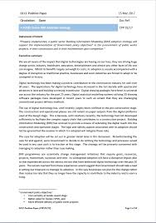
GCCC Position Paper Published 15th March 2017
Statement of intent
“Properly implemented, a public sector Building Information Modelling (BIM) adoption strategy will support the implementation of Government policy objectives1 in the procurement of public works projects, in their construction and in their maintenance upon completion.”
Government policy objectives:
Cost certainty at tender award stage
Better value for money (VFM)
More efficient delivery of public works projects

Slide 3


With the ‘National Planning Framework, Project Ireland 2040’ http://npf.ie/ the state will be delivering a large amount of Built environment infrastructure, with the physical asset, there will also be a BIM model produced which is a container for asset information, this Building Information Modelling (BIM) process is required by ‘Roadmap to Digital Transition For Ireland’s Construction Industry 2018-2021’
http://www.cita.ie/wpcontent/uploads/2017/12/NBC-Roadmap-2018-2021.pdf.

Slide 4

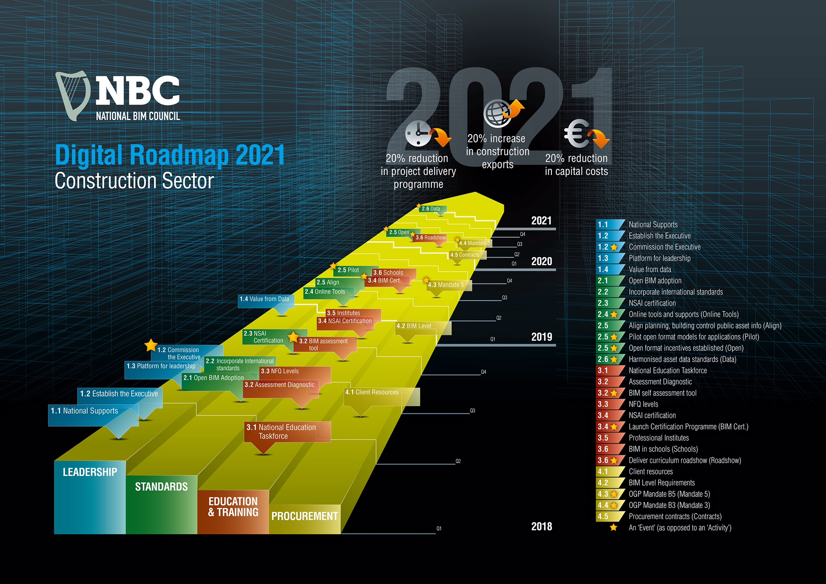

Slide 5
























Pillar 1 - Leadership
Pillar 2 – Standards
Pillar 3 - Education and Training
Pillar 4 - Procurement

Slide 6
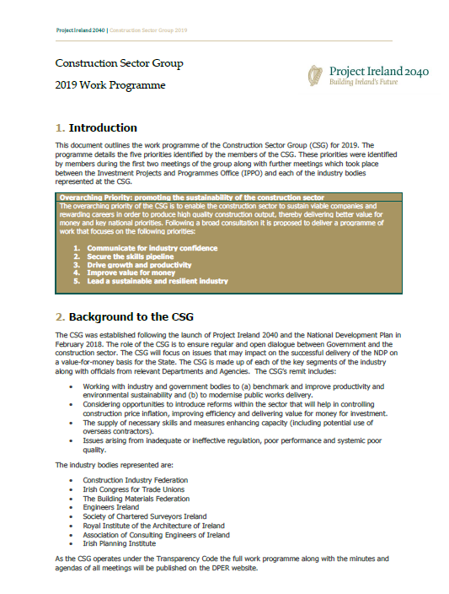
Overarching Priority: promoting the sustainability of the construction sector
1. Communicate for industry confidence
2. Secure the skills pipeline
3. Drive growth and productivity
4. Improve value for money
5. Lead a sustainable and resilient industry

Slide 7

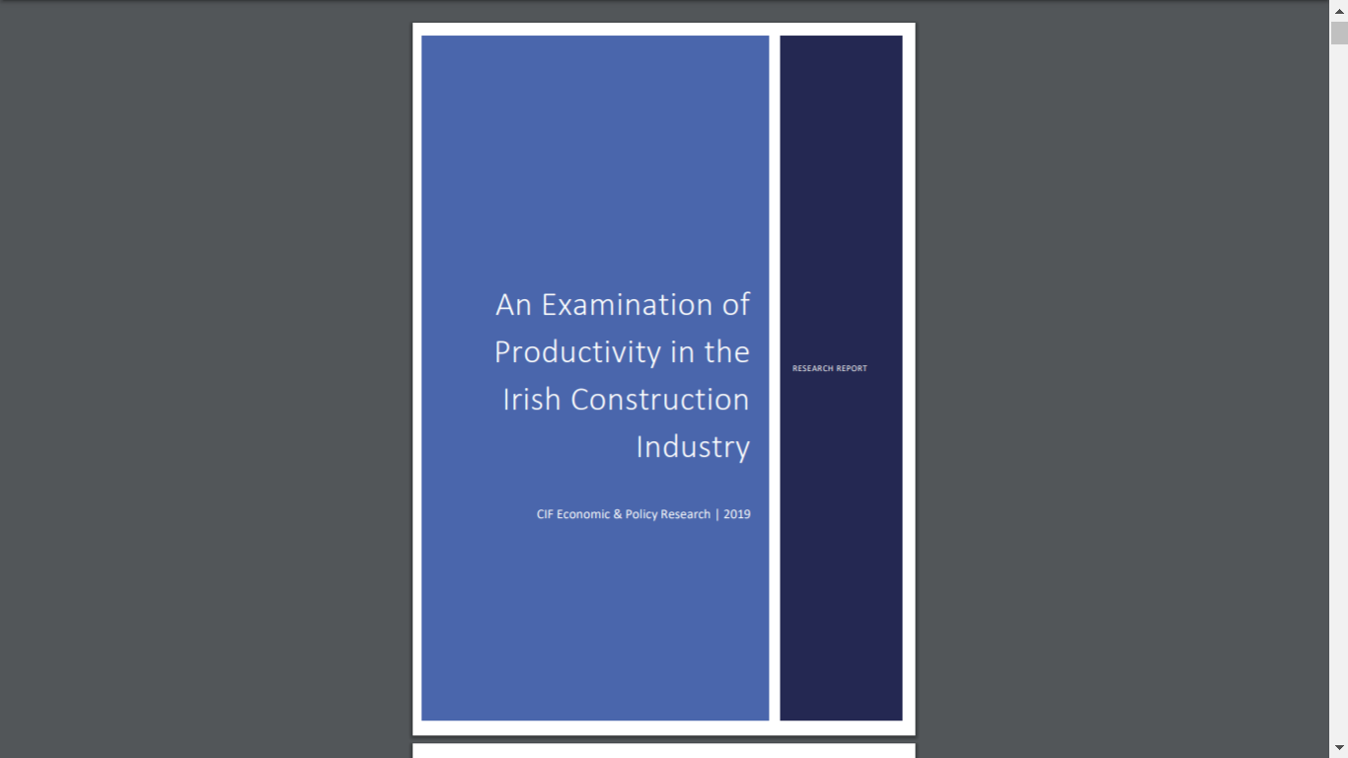

Slide 8
An overview of BIM and the public sector
Moving forward…….some initiative’s….
To achieve the Government's Policy Objectives
Cost certainty at tender award stage
Better value for the money (VFM)
More efficient delivery of public works projects
PUBLIC BIM – an Alliance of Public Sector Bodies was formed to adopt a common standard approach where possible to processes, contract amendments, protocols etc
Helen Keller once said “Alone we can do so little, together we can do so much”

Slide 9
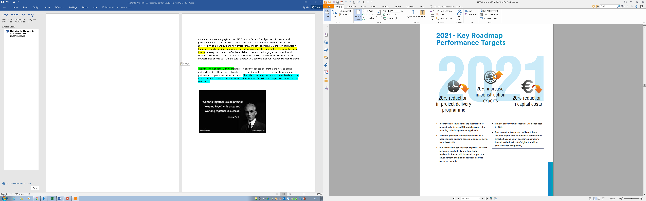
An Overview of BIM & the Public Sector
Ireland’s largest Client of Construction is the Government…… spending €5,823,000,000 in capital expenditure for 2018… a 20% reduction in Capital costs would mean a WHOPPING saving of €1,164,600,000 for the year. This alone is a major incentive to use BIM and go Digital

Slide 10
Ireland and BIM – The story to date
Private Sector –
  Tier one contractors/consultant teams/Clients are currently invested in BIM and Asset information model (AIM)
Public Sector –
  Contractors in PPP (Schools/Education and Social housing bundles)
  “Prudent Clients” in the local government authorities
But what is happening with Government Capital investment on a whole?

Slide 11
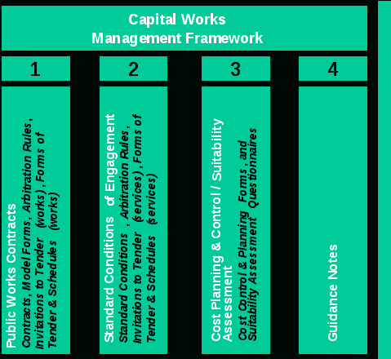
Capital Works Management Framework (CWMF)
Procurement and management of Publicly funded construction projects (building and civil)

Slide 12
Capital Works Management Framework (CWMF)
Current Requirements
Fixed price contract
Where designed by the employer – Full measured BOQ under rules of ARM4
Collaborative design
Specialist contractors can be procured in parallel and then novated to the main contract
  So why no BIM?

Slide 13
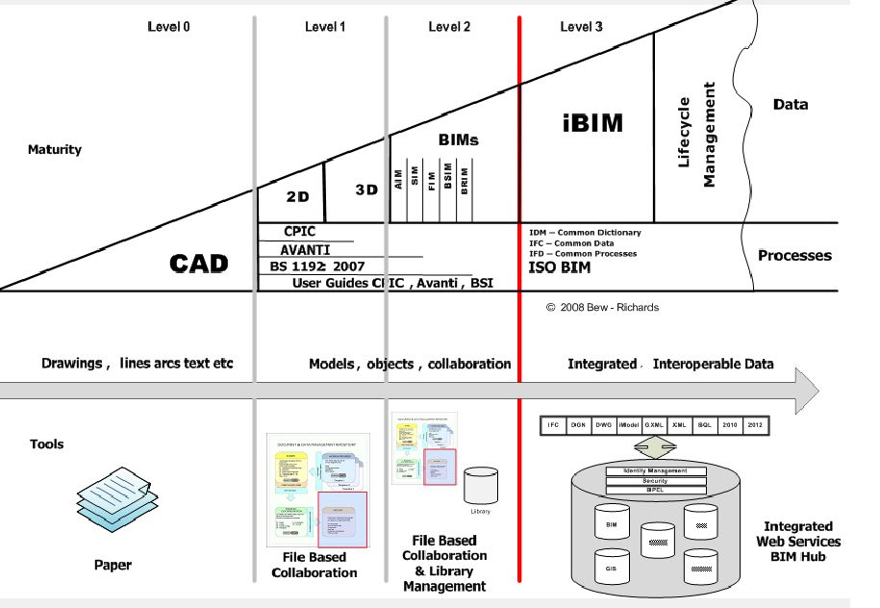
Current Situation

Slide 14
Capital Works Management Framework (CWMF)
What is the issue?
Consultant conditions of engagement
Do not encourage/support BIM implementation
Current fee levels – insufficient
Client organisations are not sufficiently aware or supported
Forms of contract do not support Early Contactor Involvement (ECI) in the majority of cases (1/11 contracts)

Slide 15

Capital Works Management Framework (CWMF)
Steps needed to resolve the issue:
Review of the CWMF
Consultant conditions of engagement – underway
Revised guidelines for the production of project brief
Review and revision of Public Works Contracts (PWC)
Revision of Cost reporting systems (ICMS)

Slide 16

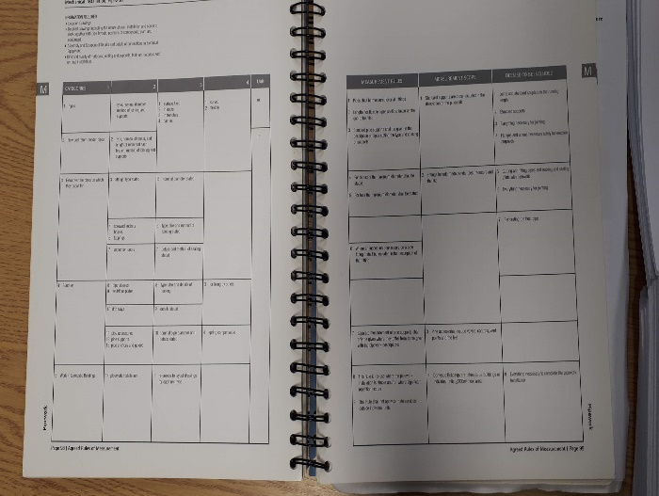
Issues with the Irish ARM4 (Agreed Method of Measurement
These rules were written for a different time! They have no clear coding and are often subjective requiring a great deal of experience to implement them. Fig 4 above shows a typical ARM4 page. In this case it shows Page 98 – Pipework.

Slide 17



Other Considerations
BIM compliant Method of Measurements
Structured costing system (ICMS)

Slide 18
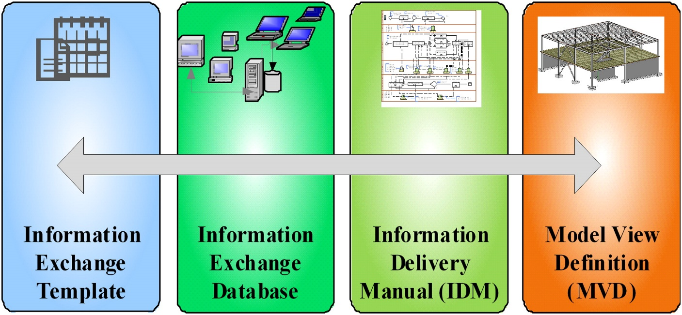
Lack of understanding of the different disciplines
QS lack of ICT skills
Lack of fully functioning & integrated 5D BIM QS software
Lack of a QS MVD (model view definition)
Lack of 5D case studies to learn from
Very little faith in the data inmost current BIM Models as they are incomplete, of poor quality & not modelled to a level suitable for the QS automatic quantification
There is a shortage of suitably skilled 5D BIM QS’s who fully understand the BIM process & have the necessary digital skills for interrogating the models pushing & pulling cost rich information
QS main issues

Slide 19
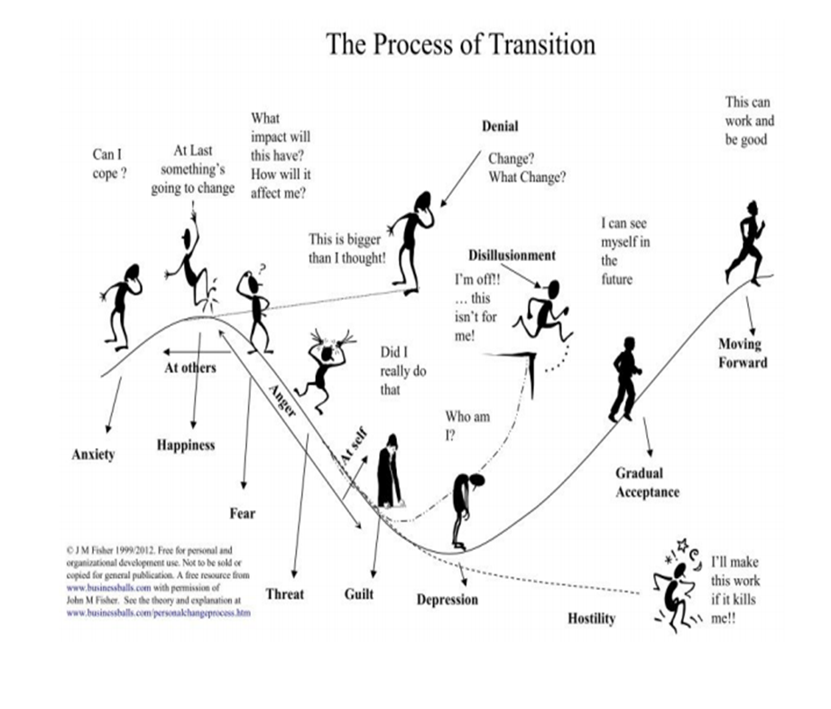
There are many risks inherent in the BIM Transformation Process, most of which can be eliminated, the remainder of which must be managed
They broadly fall into three categories:
People
Processes
Technology

Slide 20
Lack of BIM Engagement
People
Process
Technology

Slide 21
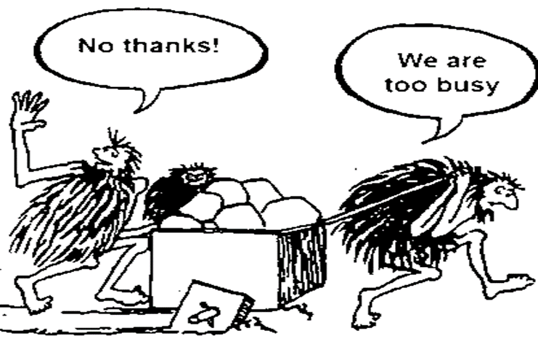

People
Resistance to change, individuals have their own preferred ways and don’t see the need to change, we have always done it this way
Fear of change, see the change as overwhelming, feel it is not a priority for them & besides they are too busy to make time to consider it
Do not understand the process or what it entails
Fears that certain aspects of their work may be
adversely affected by automation
and their value will be diminished

Slide 22
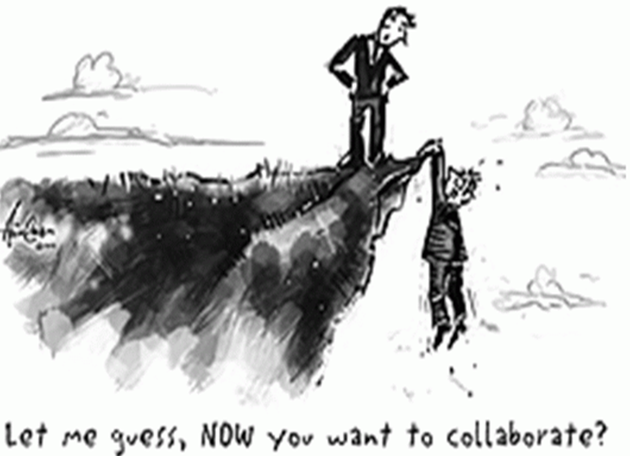
People
Creation of new roles e.g. BIM Manager, Project Information Manager, BIM Technician
Lack of leadership, governance & direction
Skills shortages/recruitment of Key personnel
Demystification & simplification of the
processes and terminology
Numerous myths & misconceptions e.g.
BIM is only about software. BIM can be rolled
out by CAD technicians
Lack of management vision and buy-in

Slide 23
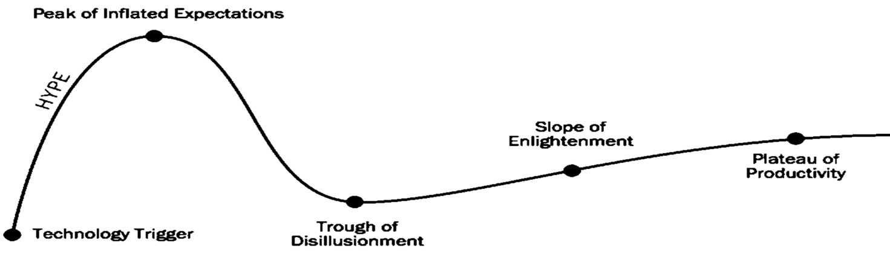
People
Difficulty engaging in collaboration coming from a silo background….. fear/blame
Fear of what organisational changes might mean to them as a person and what the future will look like

Slide 24

Difficulty of creating business process opportunities cross multiple silos
IT/OT gaps. Adopting IT systems to cloud based environments
Lack of SMP’s, protocols etc.
Insurance implications
Open data

Slide 25
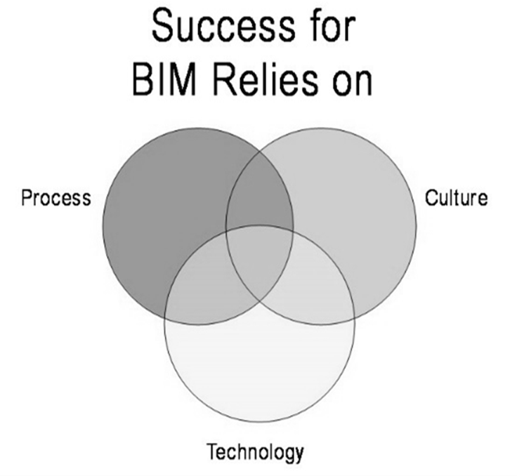
Process
Disruption, incremental
Lack of agreement of Industry standards
Lack of understanding of the processes
Risk averse culture
Risk management
Data security, confidentiality, privacy
GDPR

Slide 26
Technology
Significant rise in the use of IoT and other emerging technologies
Software interoperability issues, loss of data transfer
Sensitive information
Limited analytics talent
IT/OT
Who owns the Cloud?

Slide 27
Technology
Disruption
Legacy Technology requiring significant investment
Technology not suitable for streamlined processes
Use of Multi technologies to perform different functionalities
The rise of cyberattacks and security issues

Slide 28
The way forward
Advocate for BIM Mandate and set timeline – Roadmap for Digital Transformation in Construction
Training for clients
Training for SME (contractors and consultants)
Interoperability of software
Digitisation of documentation (machine readable)

Slide 29
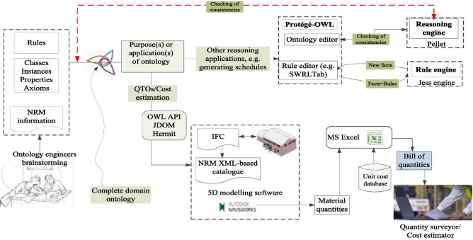
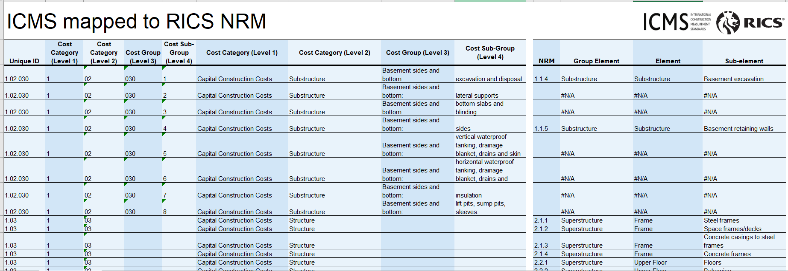

Slide 30
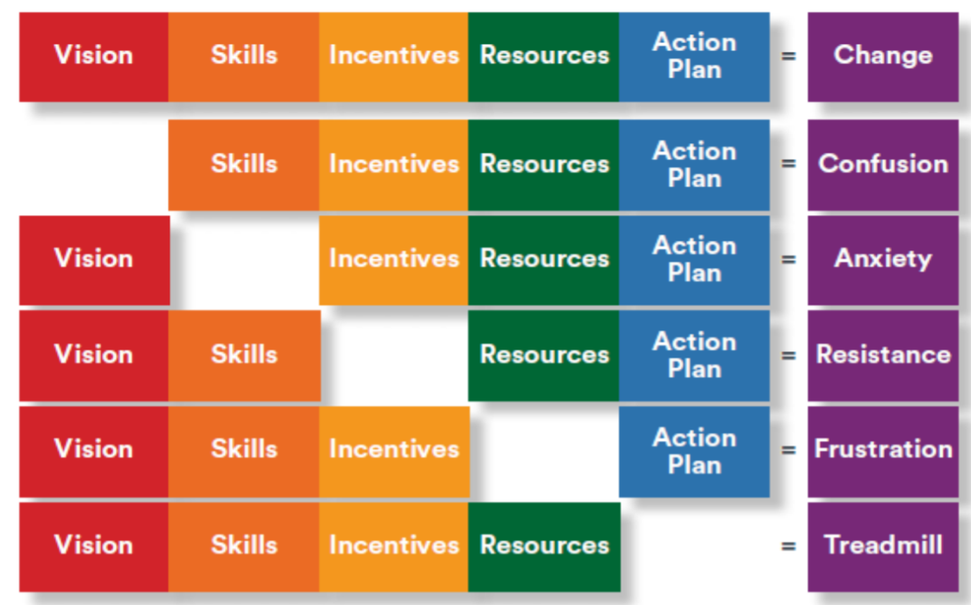
Time
For
Change
Not Quite There Yet!!

Slide 31

Future of 5D BIM

Slide 32
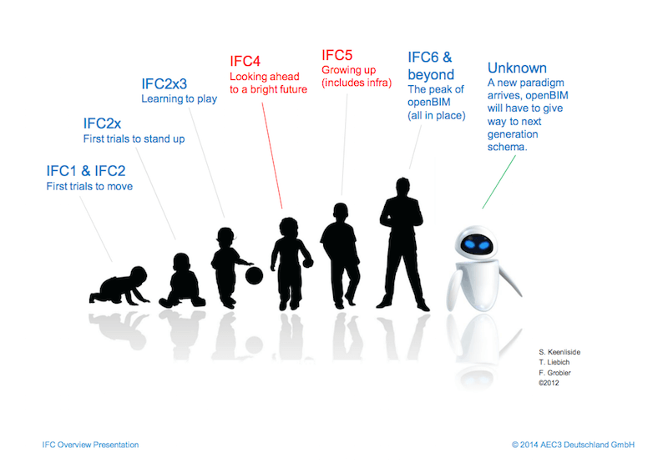
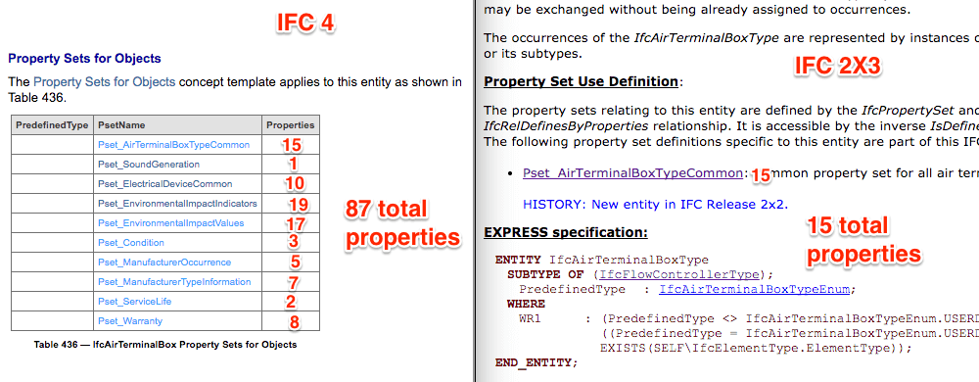
The future within the next 2 years

Slide 33
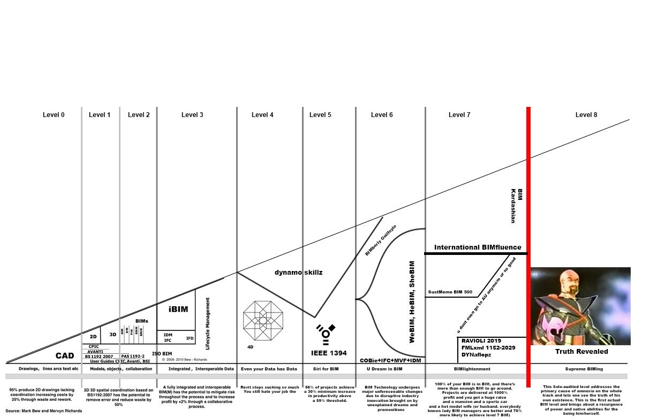
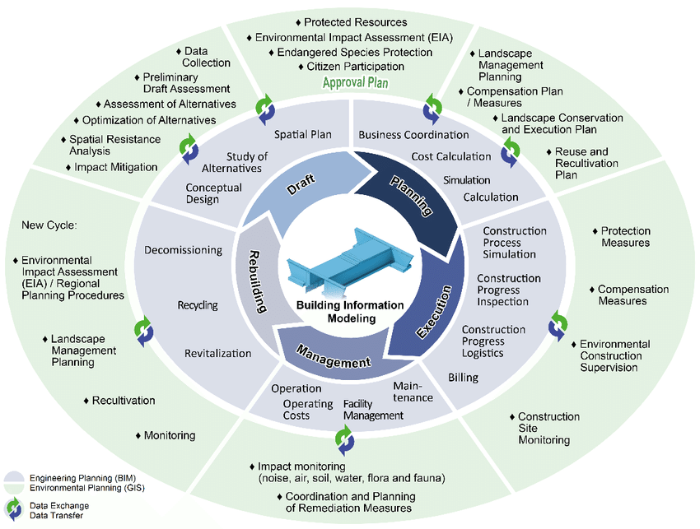
The future 5 to 10 years from now

Slide 34
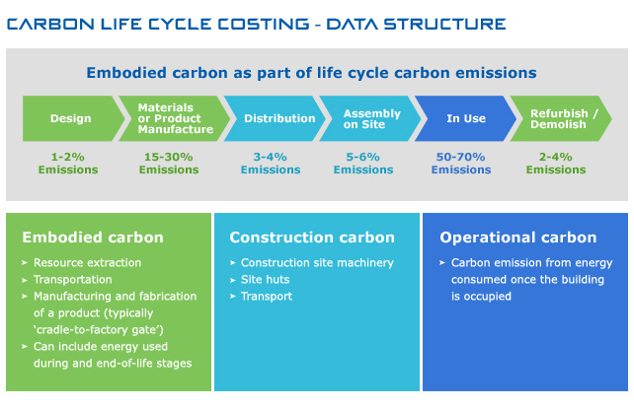
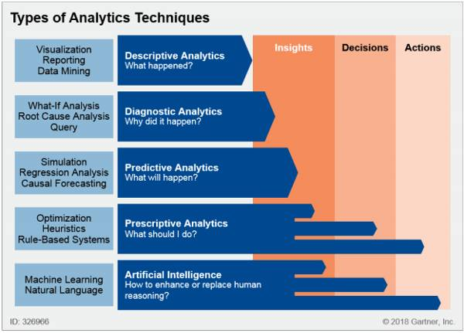
Taking care of the climate
Its all about the Data!!

Slide 35

Thank You!
Any Questions?

