Slide 1
ETA route for the CE marking of Construction products
ETA awareness – October 11th, 2019

Slide 2
Content
EOTA – European Organisation for Technical Assessment (TABs)
EAD – European Assessment Documents
ETA – European Technical Assessments (CE marking)

Slide 3
  Cooperation among TABs as from 50s.
  1990 Foundation of EOTA. Construction Products directive (89/106/EEC) - CPD
  2013 came into force CPR - European Organisation for Technical Assessment (2011/305/EU)
  2019 EOTA represents 52 TABs designated by European Member States (EEA, Turkey y Switzerland)

Slide 4
EOTA and construction sector
Art 31.4 Construction Product Regulation (CPR) regarding EOTA:
Coordination of TABs and Stakeholders.
Ensure best practice.
Procedures and support for the EADs development.
Develop and adopt EADs.
Inform about EADs and suggest improvements based on experience gained.
Inform EC / MS about a TAB not fulfilling its tasks.
Public availability of EADs and ETAs.

Slide 5
EOTA and Construction Sector
CPR 305/2011
National approval system
hEN
EAD
ETA
ETA
ETA
Declaration of Performance
CE marking
EU market

Slide 6
EOTA and Construction Sector
CPR | Documents | Organisations
Art 4-9 | CE marking / DoP | Manufacturer
Art 22 | EAD cited in OJEU | European Commission (EC)
Art 26 | ETA issued | Technical Assessment Bodies (TAB)
Art 19, 24 | EAD adopted | EOTA
Art 21 | ETA request | Technical Assessment Bodies (TAB)
Art 21 | ETA application | Manufacturer
Construction Products Regulation (CPR) Stakeholders:
Standing Committee on Construction (SCC), Advisory Group (AG), Manufacturers, Contractors, Notified Bodies, Notifying Authorities, Market Surveillance, European Committee for Standardization (CEN) and EOTA.

Slide 7
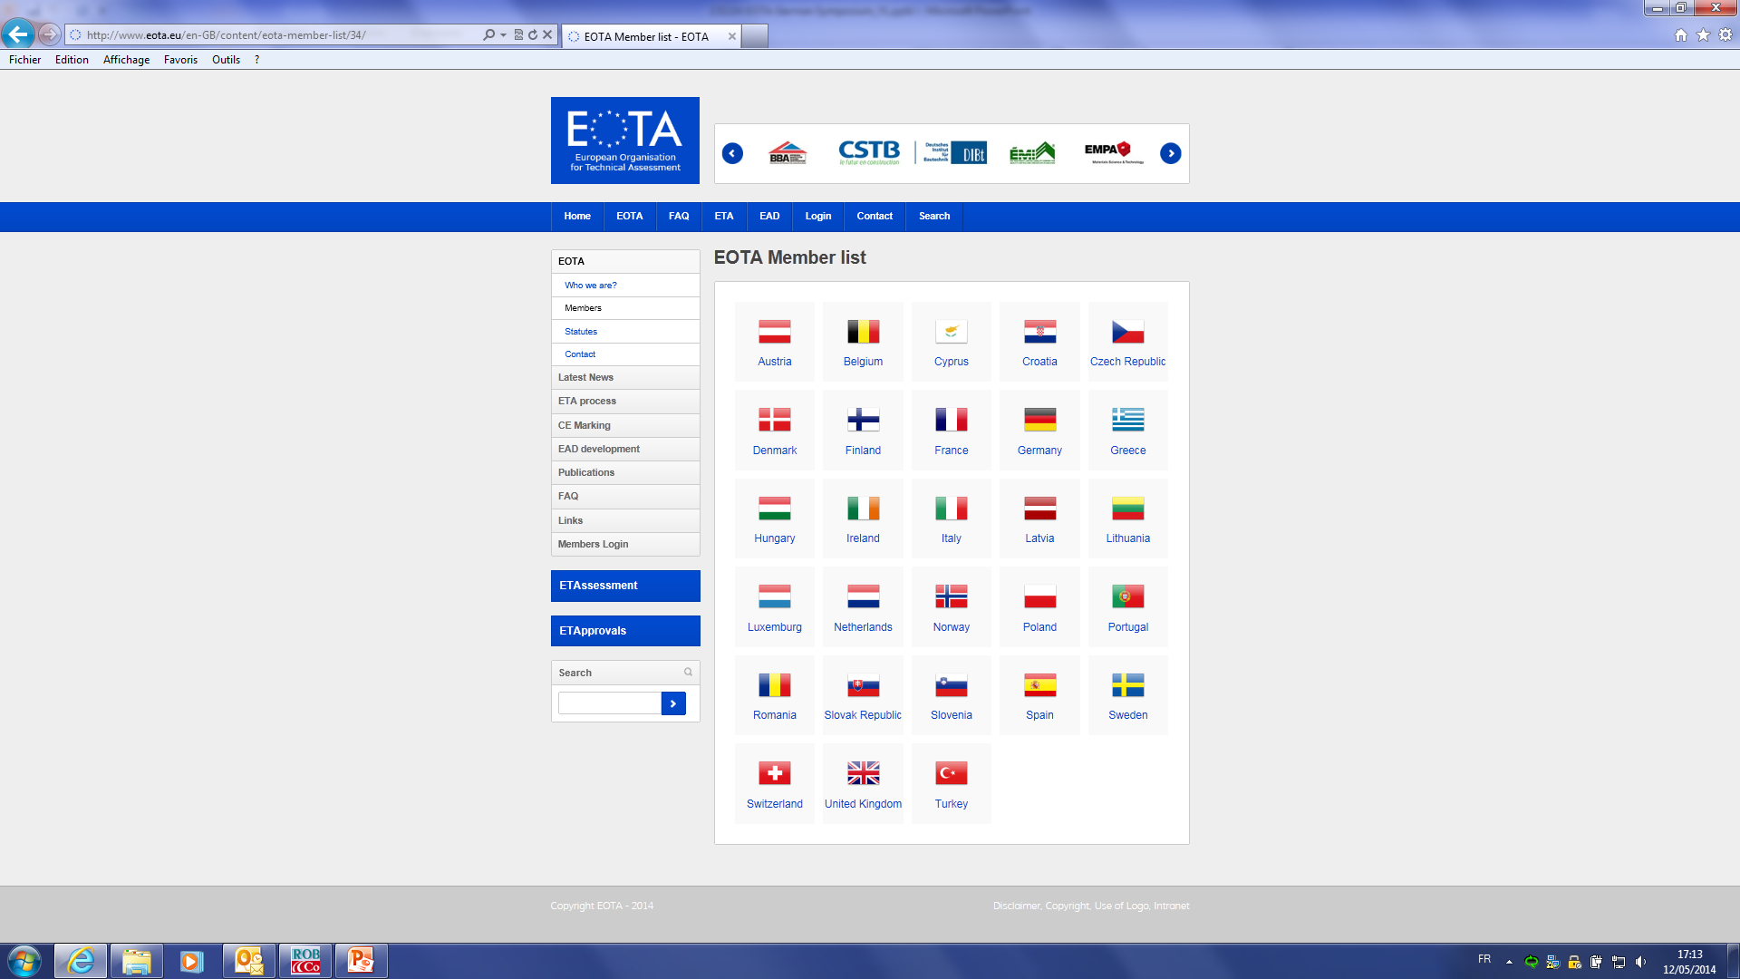

Slide 8
EOTA bodies
General Assembly (GA)
President
Executive Board (ExBo)
Communication (CWG)
Technical Board (TB)
Financial WG (FWG)
Secretariat
European Assessment Document EAD
European Technical Assessment ETA
Technical Assessment Bodies (TABs)

Slide 9
Financial restraints
Regulation (EU) 305/2011
- CPR -
Model for
ETA Application
Organisation
Regulation (EU) 1062/2013
on ETA format
Recommendations for
Service Agreement
ETA process Step-by-step
Delegated Acts
Quality
&
Consistency
Consultations and
Handling of ETA/EAD
EOTA Statutes
Work Programme
EOTA
Internal Regulations
How to write an EAD
EOTA
CMS*
How to write an ETA
National regulations
Network environment
Layout model for ETA
Market conditions
*) Consistency Management System

Slide 10
Content
EOTA – European Organisation for Technical Assessment (TABs)
EAD – European Assessment Documents
ETA – European Technical Assessments (CE marking)

Slide 11
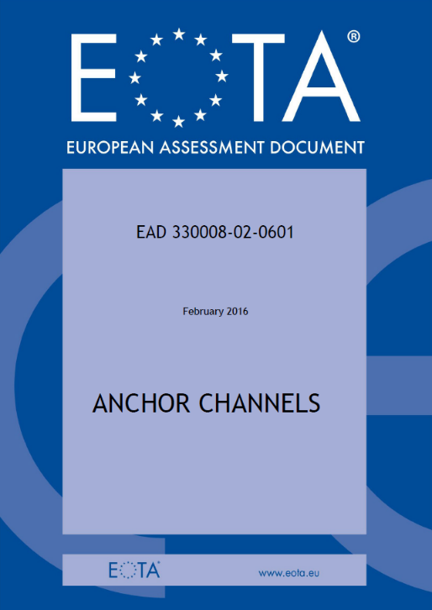
  CPR (EU) No 305/2011
    Coordination of TABs
    Development of EADs
    Support to the issuance of ETA
    Guarantee public access to EADs and ETAs

Slide 12

  Objectives of EOTA
    Support innovation
    Promote free circulation of construction products
    Facilitate competitiveness in the construction industry

Slide 13
European Assessment Documents (EAD)
  EADs provide several advantages over standardisation process:
    Develop in parallel and in connection to the specific construction product (tailor-made);
    The manufacturer great influence in the final EAD;
    Confidentiality during the EAD development; it is possible collaboration with professional associations;
    Development of the EAD in an expert Working Group on the specific construction field (36 PAC - Product Area Codes);
    There is no need for mandate of the European Commission;
    Defined deadlines for the EAD adoption.

Slide 14
European Assessment Documents (EAD)
  …
    Development of EADs and ETAs are an opportunity and not an obligation (hEN);
    The manufacturer does not support any cost related to the EADs development;
    Coherence between EADs and hEN (EADs include harmonised test at European level).

Slide 15
Working Groups (52 TABs 36 PACs)

Slide 16
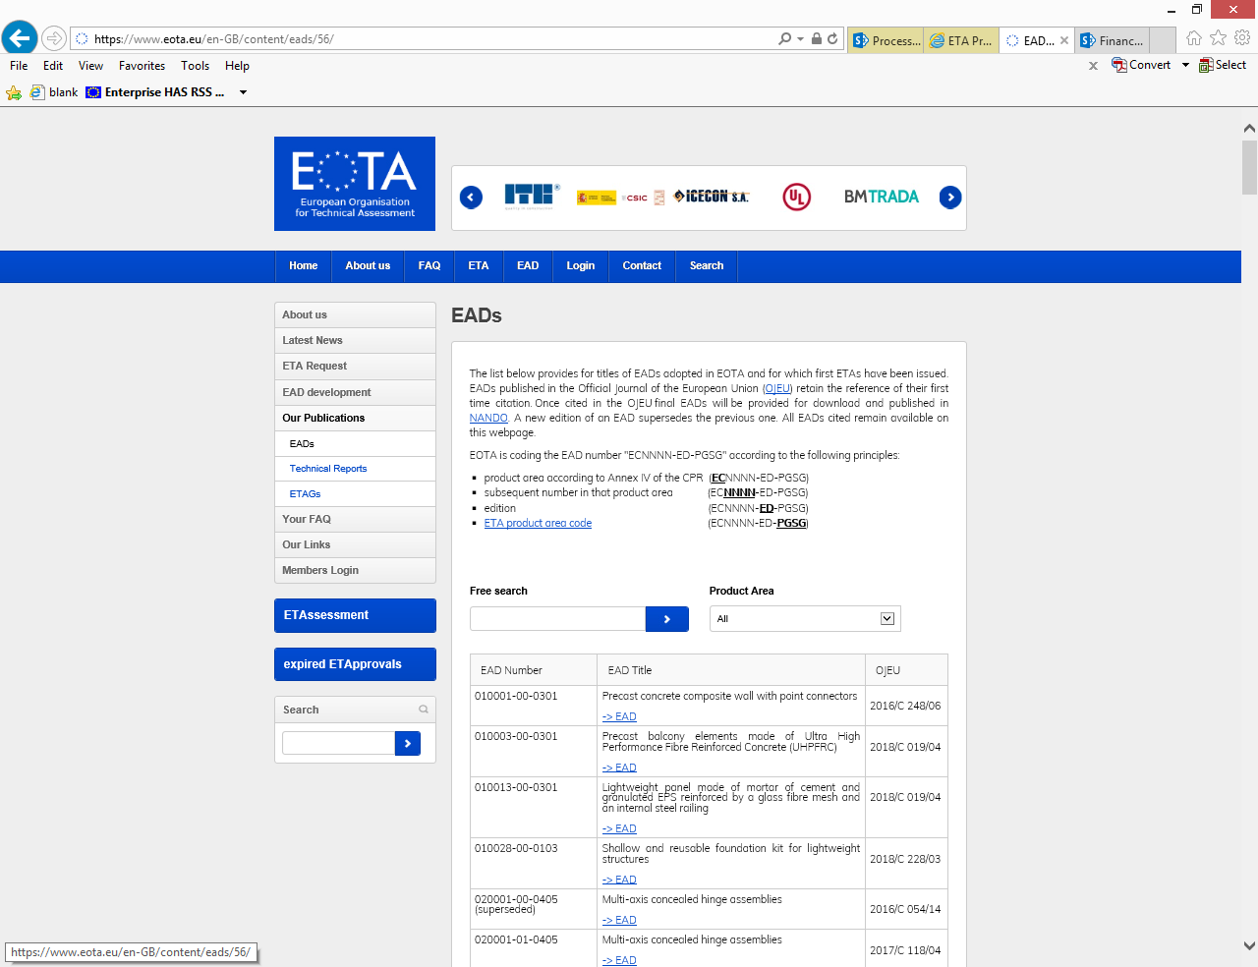
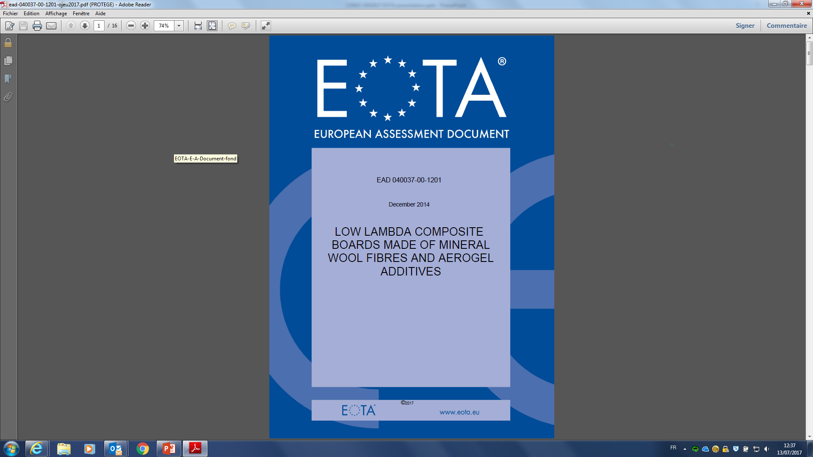
EADs free of charge in our website (OJEU)

Slide 17
Content
EOTA – European Organisation for Technical Assessment (TABs)
EAD – European Assessment Documents
ETA – European Technical Assessments (CE marking)

Slide 18
Why ETAs?
  ETAs provide an alternative and voluntary route for the CE marking:
    Innovative products,
    Niche products,
    Characteristics of the product not included on hENs
  ETAs promote transparency as part of the harmonised scheme for the essential characteristics of construction products (DoP)
  ETAs are a relevant tool to promote free circulation of construction products
  AVCP similar to hEN guaranteeing DoP
  The Assessment process supports the optimization of the construction products
  CE marking improves manufacturer´s visibility

Slide 19

Assessment Report of the European Commission
  Benefits of the ETA overcome their costs.
  Manufacturers who obtain ETA, request for new ones.
  ETAs are accessible to SMEs.
  CE marking improves manufacturer´s sales.
Source: DIBt, Berlin

Slide 20


Construction Product art. 21 CPR
ETA
/
EAD
Declaration of Performance
Internal Market

Slide 21
ETA verification
  https://www.eota.eu/pages/etassessments/default.aspx (ETAs)
  https://www.eota.eu/en-GB/content/eads/56/ (EADs)
  http://ec.europa.eu/growth/tools-databases/nando/index.cfm?fuseaction=directive.notifiedbody&dir_id=33 (TABs / NBs)

Slide 22
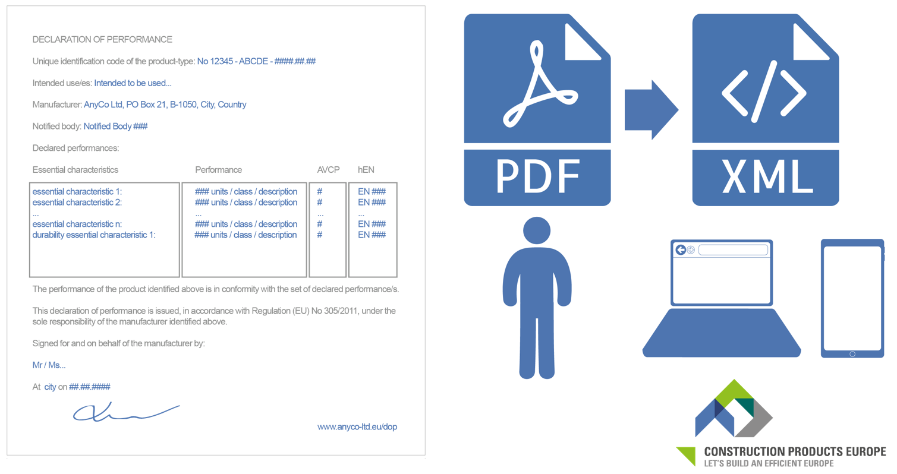
Smart CE marking
  Smart CE marking (.XML format): Construction Products of Europe (https://www.construction-products.eu/services-jobs/smart-ce-marking )

Slide 23
Achievements 2013 - 2019
230 EADs published in the OJEU
300 EADs adopted and valids to issue ETAs
430 EADs in development
More than 65 EOTA TR (Technical Reports) published
7100 ETAs issued by our Technical Assessment Bodies (TABs)

Slide 24
Statistics of EADs in EOTA

Slide 25
Statistics of ETAs in EOTA

Slide 26
Thanks!
Sergio Vazquez Jimenez– Secretary General
info@eota.eu – www.eota.eu

